Slide 1
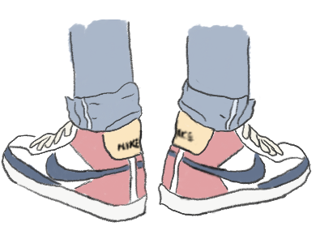
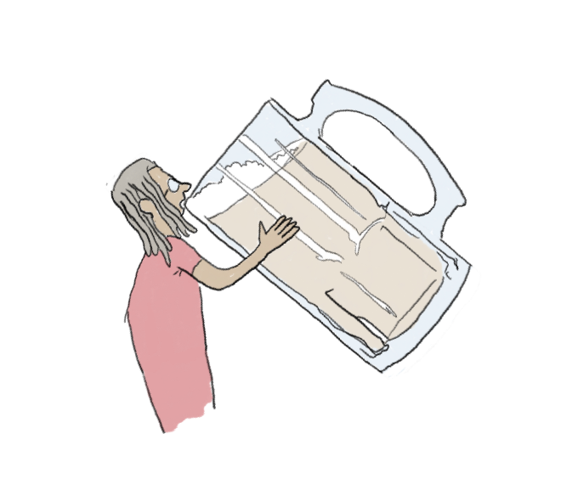
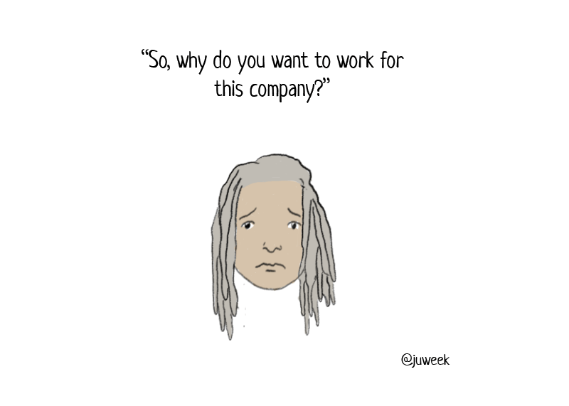
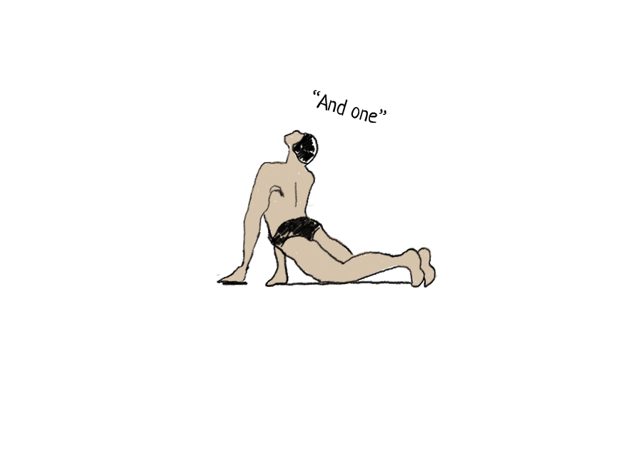
2 years ago, our hero was defeated, getting denied from the 2019 Adobe Creative Residency.
At first, he took it...hard. But he knew the opportunity would come again.
So he trained. He became wiser, and more mature.
And now, he comes back ready to apply. Will he succeed?
Juweek Adolphe
Illustrator/Creative Coder

Slide 2
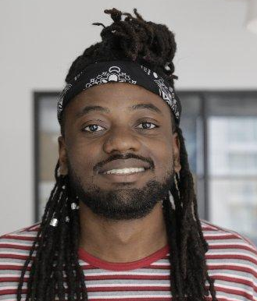
*This is how I look like

Slide 3
Wait!
There is an animated version of this proposal. That is a better representation of my skills
juweek.github.io/monte-carlo

Slide 4
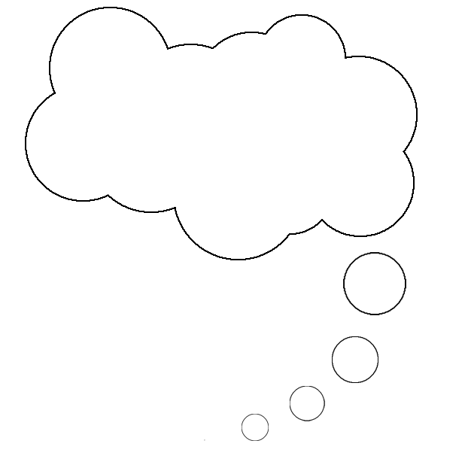
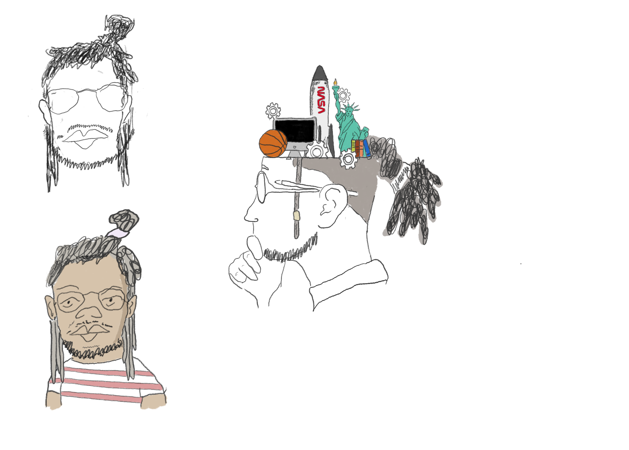
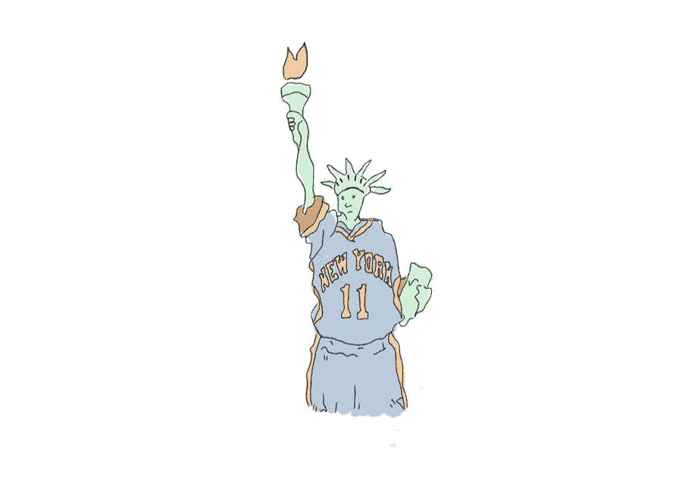
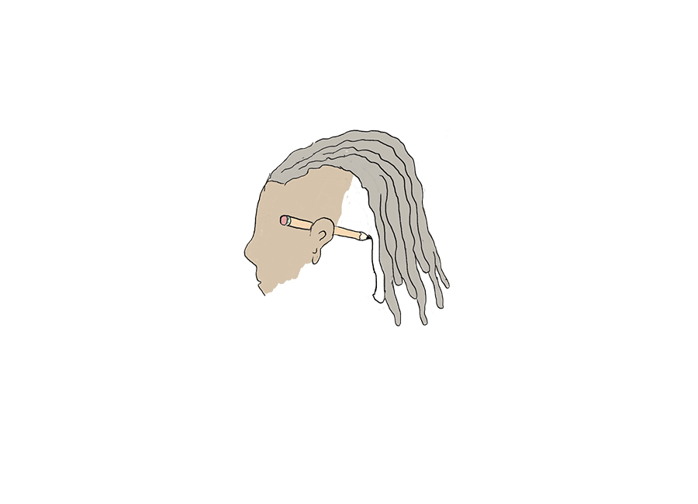
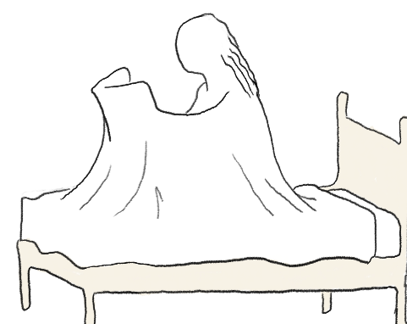
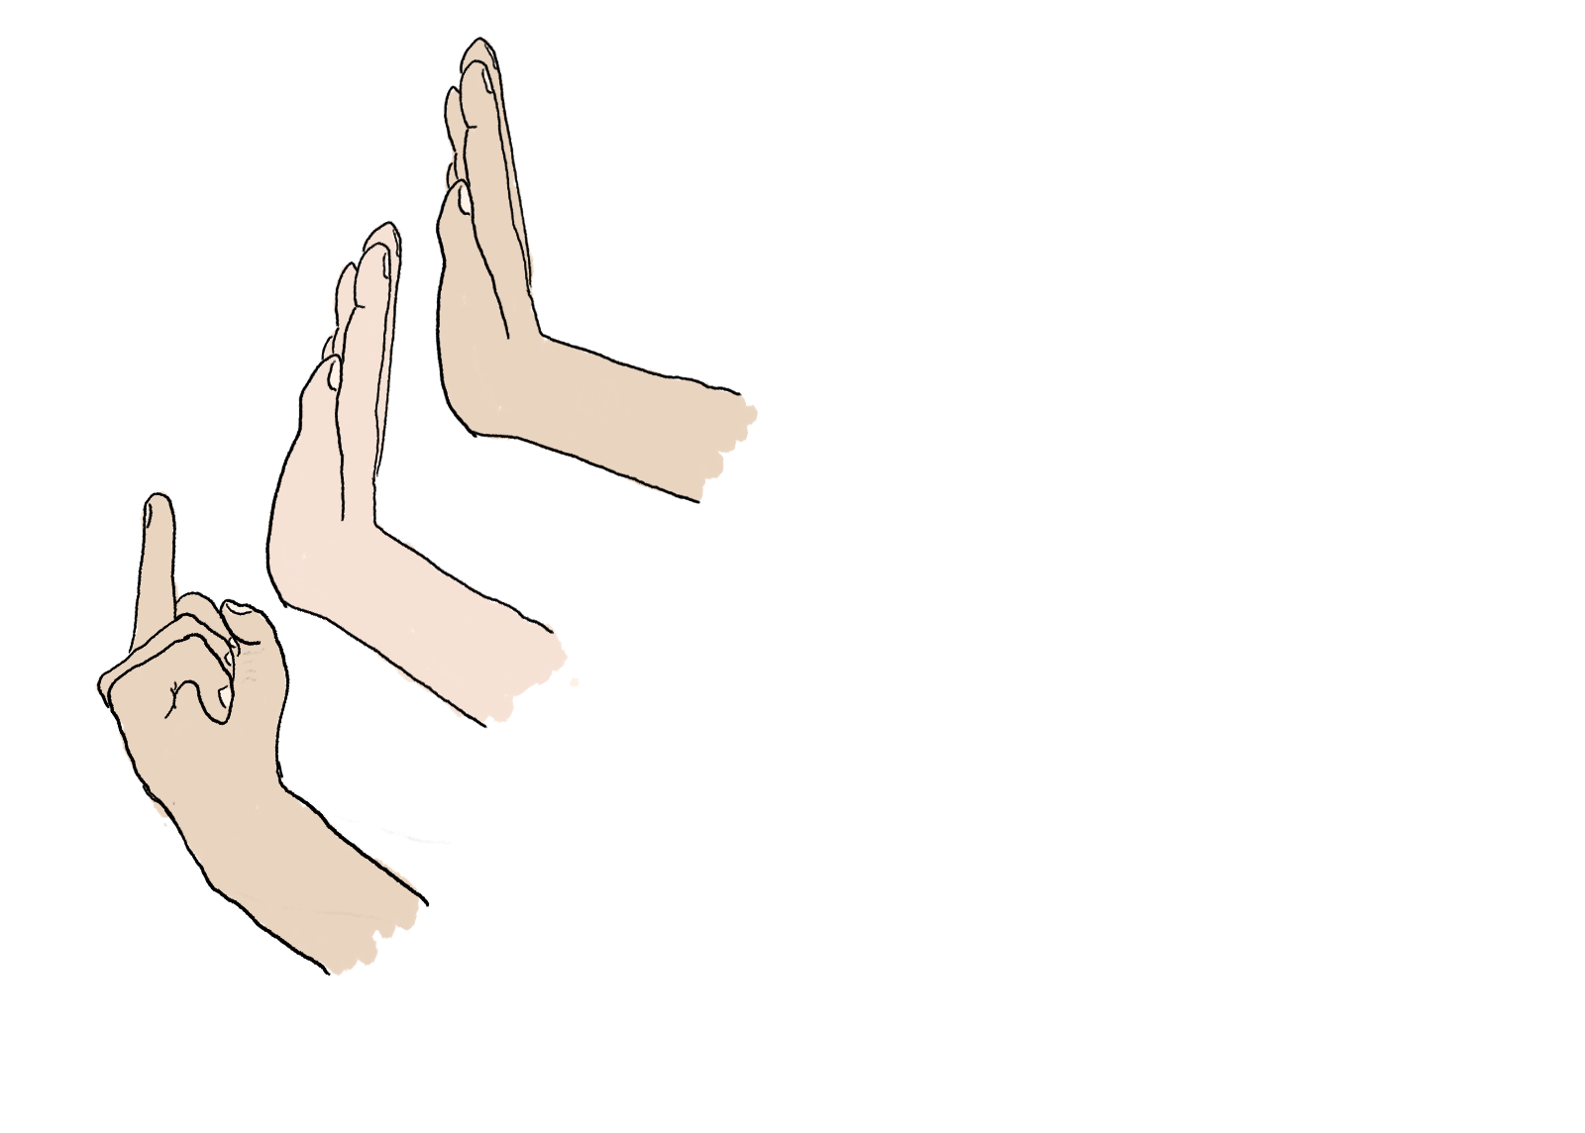
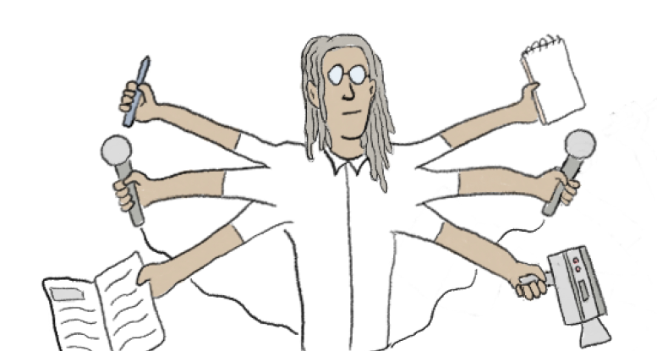
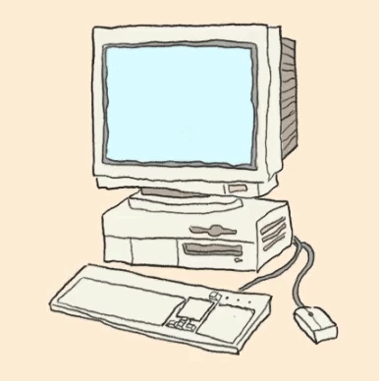
Today, we take a look at our hero, Juweek, and his Adobe application.
Will he get it? The chances aren’t likely, but I guess we’ll have to wait and see.
The Introduction
....uh, thanks...
Hi, I’m Juweek. I’m the hero.
That narrator is kind of a jerk.
I’m 26, and I live in Brooklyn, NY. I’m the son of two Haitian immigrants, and a fan of basketball.
Most of all, though, I’m a huge comic book nerd. I have been since I was a kid.
Naturally, it was only a matter of time before I started drawing.
The Personality
Professionally, I’m a “creative coder”. It’s hard to explain, but basically I make websites, and they tend to veer on the more artistic side.
Most companies don’t have a need for “creative coders”. However, there was one place I found that encouraged my mixing of different skills.:
JOURNALISM!
The Art
Notes:
Introduction
3-5 sentences about you, including name, location, creative field, defining attributes, 1-2 of your relevant hobbies / passions

Slide 5
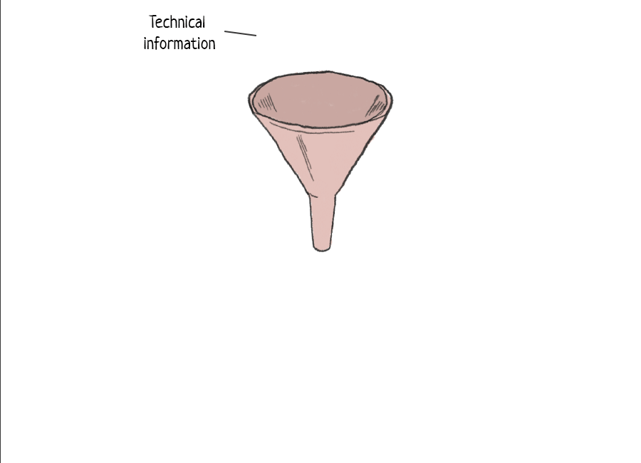
The Artist statement
Juweek is a journalist who combines multiple creative disciplines to create visual and interactive stories.
At the core of his essence, Juweek is a swiss army knife, and he cares a lot about breaking convention when it comes to creative work.
Notes:
Artist statement
3 sentences about who you are as an artist, your value to your future clients, and what drives your creative vision.

Slide 6
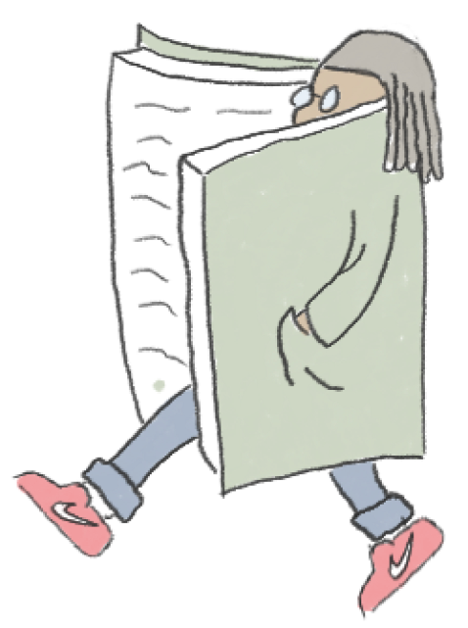
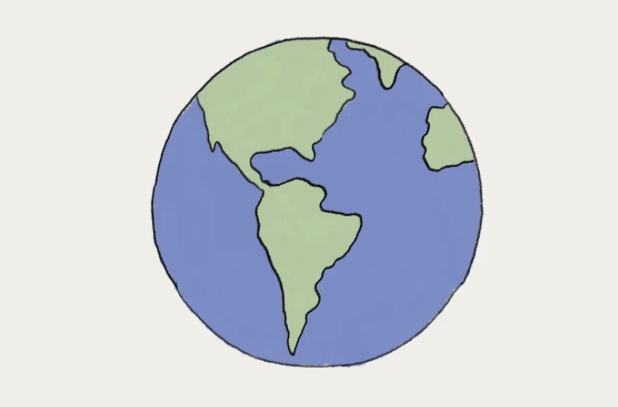
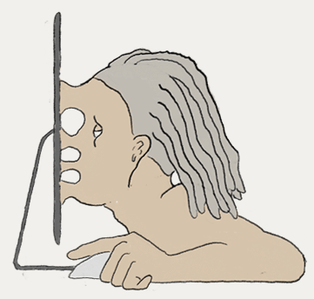
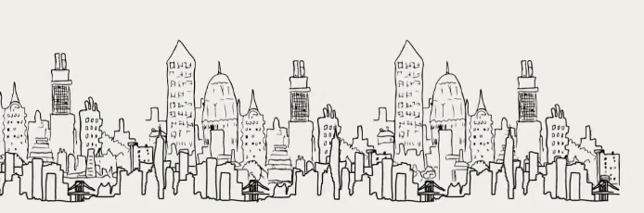

Episode 1:
The College Years
My background starts with college, where I studied Computer science. Around that time, my head was always inside of a book.
I kept up the pattern, joining two research labs, and helped start a third one at my college (I got to work with NASA on that third one).
I graduated college with a love of learning, and an obsession of everything STEM-related.
2016
Episode II:
Odd Jobs Era
I moved to New York to start my career in 2016. The gigs I got were...ok.
*Shudder* I don’t like talking about this period that much.
They sucked, actually. I was constantly put in boxes, and I never had opportunities to explore.
2017 - 2018
Episode III:
The Guardian
Eventually, I stumbled into a job at the Guardian, and I fell in love.
I was a visual journalist, so I created special interactive web pages for news stories. It was the first job where my code skills were used alongside my design and drawing skills, and I’m really proud of the work I did while there.
I left the Guardian after the 2020 elections, but I left with a hunger for opportunities to do more of that type of hybrid work.
2018 - 2020
Notes:
Introduction
3-5 sentences about you, including name, location, creative field, defining attributes, 1-2 of your relevant hobbies / passions

Slide 7
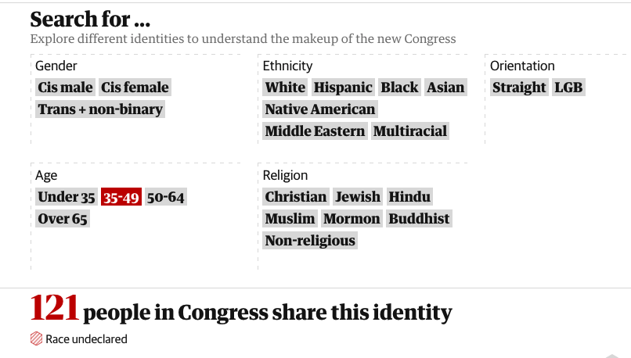
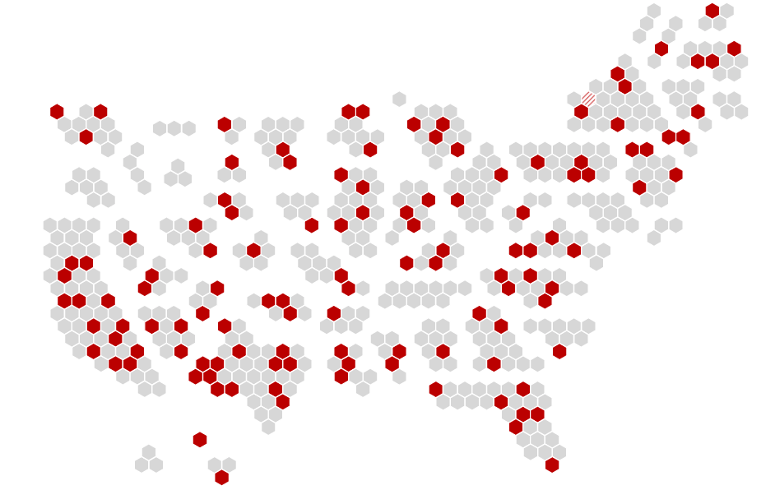
Congressional Map
In 2018, I created an interactive map of the members of the newly elected Congress.
The map cross-referenced each congressperson’s location with their demographic data. Users were able to click on an identity, and the map would filter itself to only show congresspeople who identified as the chosen identity.
This project was a perfect example of how my projects usually involve multiple disciplines: it includes design, data visualization, and code.
Link: https://www.theguardian.com/us-news/ng-interactive/2018/nov/15/new-congress-us-house-of-representatives-senate
Notes:
Artist statement
3 sentences about who you are as an artist, your value to your future clients, and what drives your creative vision.

Slide 8
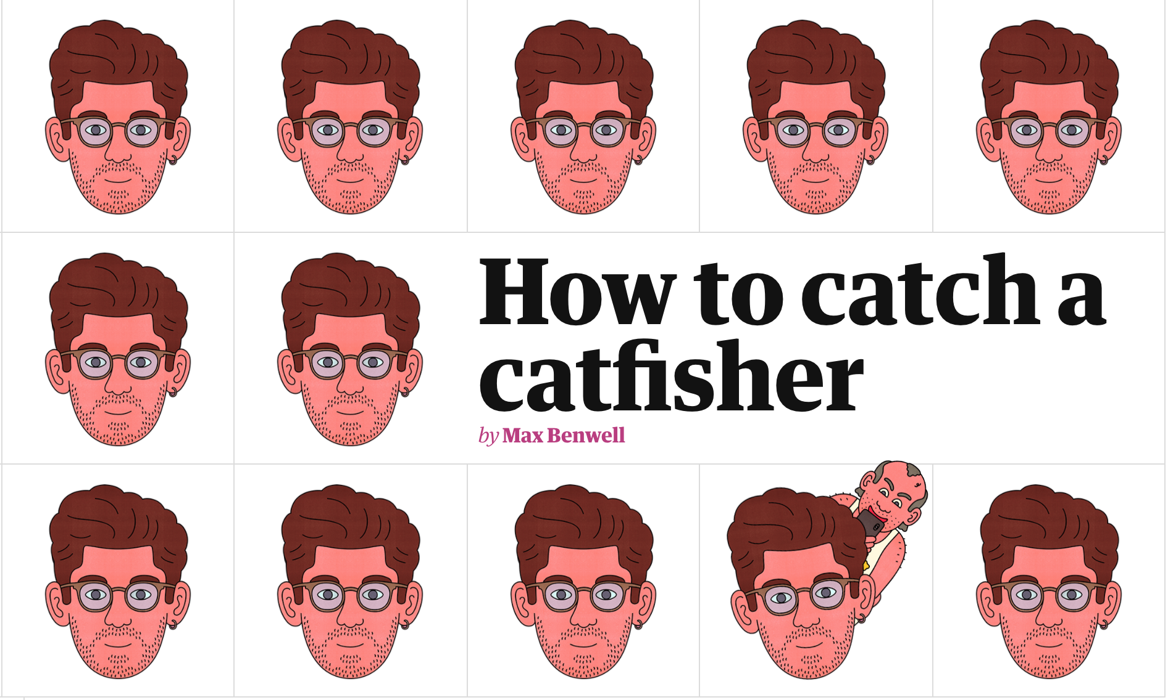
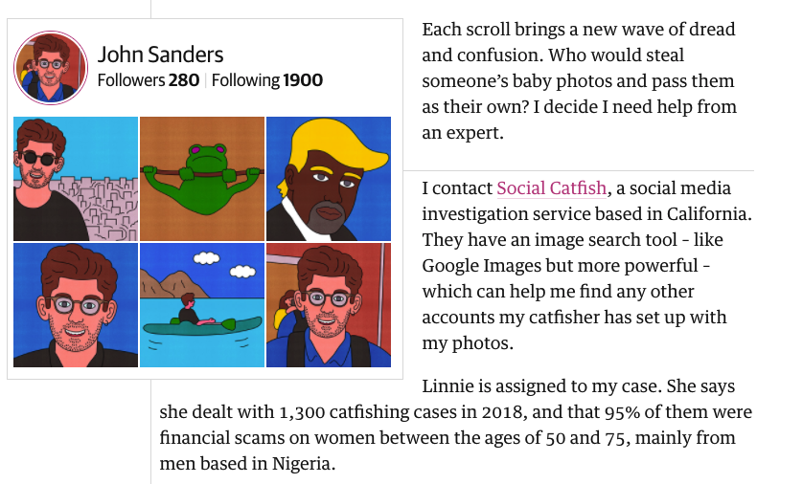
How to catch a catfisher?
How to catch a catfisher was the first iteration of me mixing illustrations with code. Working with an illustrator, a writer, and a fellow web designer, I helped craft a unique storytelling experience, with elements of the story being coded and animated at certain points.
This project is a good prototype of things that are possible when combining code and illustrations; it was a good example of how a storytelling experience can be enhance.
Link: https://www.theguardian.com/technology/ng-interactive/2019/feb/20/how-to-catch-a-catfisher
Notes:
Artist statement
3 sentences about who you are as an artist, your value to your future clients, and what drives your creative vision.

Slide 9
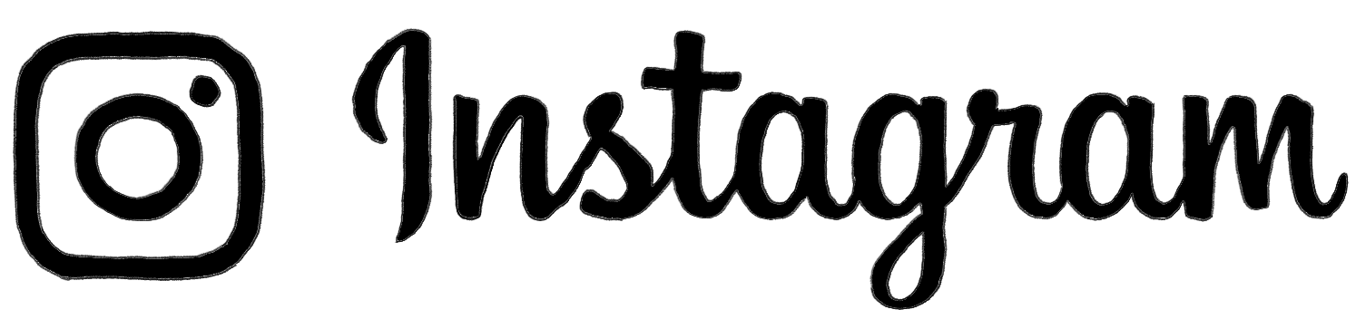
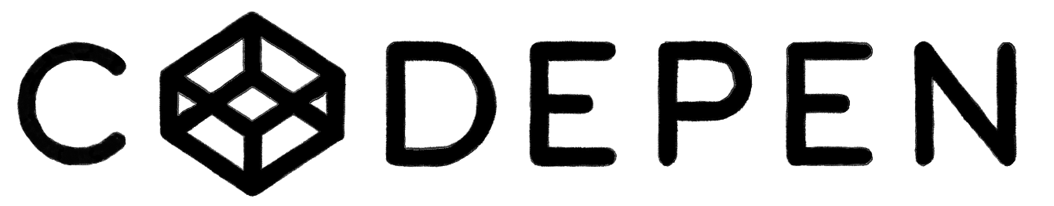
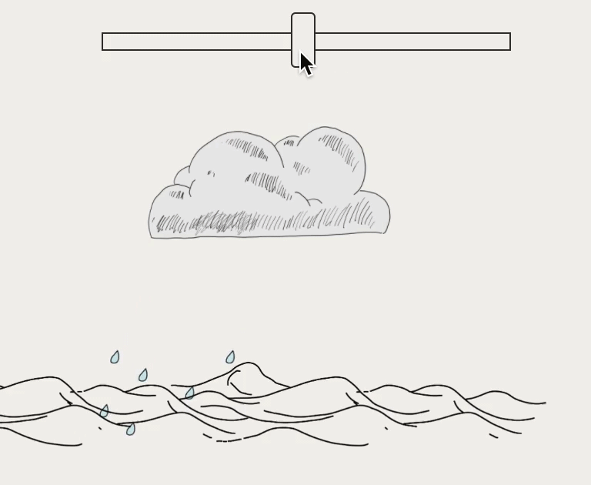
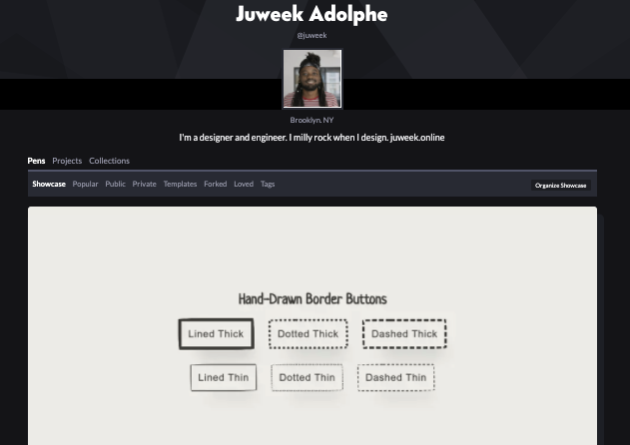
Social media sites
Aside from my portofolio side (juweek.online), you can get a vibe of my art using social media. I have both an Instagram and a Codepen that I use to short my work.
instagram.com/jujucomics
codepen.io/juweek
Notes:
Artist statement
3 sentences about who you are as an artist, your value to your future clients, and what drives your creative vision.

Slide 10
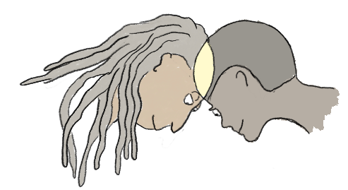
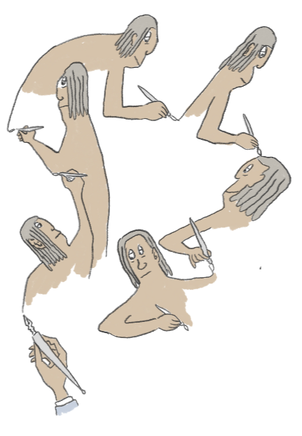
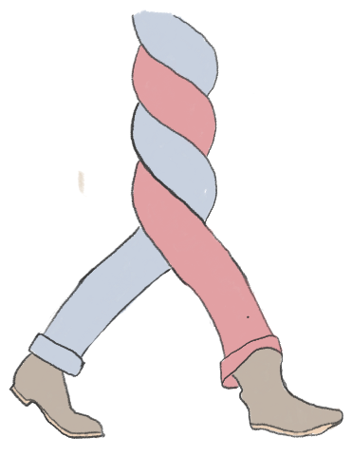
Where I want to be
It is my goal to find and build up members of what I call the ‘hybrid community’. By meeting interdisciplinary creatives, it’ll be easier for me to find work, push my creative limits, and start to build a community around me and fellow creators that share my sentiments.
I want to create stories full-time. Storytelling is an experience where there are no hard rules, and there’s no telling where my work can end up. This might look like me becoming a freelance content creator, or it might manifest into things like ebooks, blogs, tv shows and more.
I want my work to continue to be interdisciplinary. I enjoy being a swiss army knife, and I’d like for my work to never be limited to just one creative discipline.
Notes:
Introduction
3-5 sentences about you, including name, location, creative field, defining attributes, 1-2 of your relevant hobbies / passions

Slide 11
Other people who’ve been able to achieve my dream
Andrew Hussie is the creator of Homestuck, a famous webcomic epic that incorporated gifs, gameplay, and great storytelling.
Randall Munroe is the creator of XKCD. While it is not animated nor interactive, if often deals with STEM concepts and has a vibe I’d generally like to mimic.
Nicky Case is a game developer famous for making online games and essays that help explain complex topics.
The company Brilliant has an app that uses visuals and games to explain science topics to its users.
Journalism publications, like Pudding.cool, are increasingly accepting of multidisciplinary work and unique storytelling experiences, and I can see myself creating content with them on a freelance basis.
Mona Chalabi is a data journalist who is famous for making graphs that incorporate illustrations.
Notes:
Career goals
Where are you and your work now?
If you’re pivoting into a new industry, style, workflow, etc., explain
Intended audience
Ideal clients and why
How Adobe fits into your journey from where you are to where you’re headed

Slide 12

Now, time for the actual project...

Slide 13
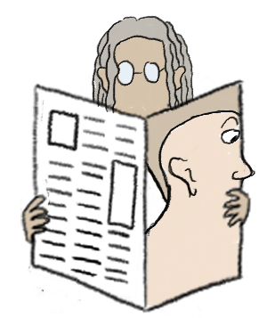

What is an interactive comic?
My idea is to create a comic strip about the world. This comic strip will be illustrated, animated, and coded by me.
Not every comic will be the same. Some will be animated, some will be interactive. Still, each will be have a life of its own.
Comics are a weird way to teach, but they shouldn’t be. They offer tools like abstraction that makes it easier to think about complicated topics.
Ultimately, the goal is to create a webcomic that serves as an accessible introduction to STEM concepts.
An interactive comic is a comic that is created using code and incorporates things like buttons and other web interactions to help tell its story.

Slide 14
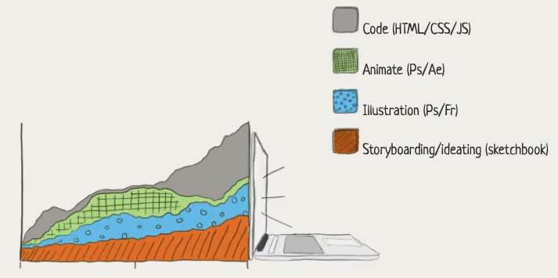
My Process
It’s often tough to describe my process because of all the different parts of it, but I’ll do my best. It always starts with an idea, whether it stemmed from a doodle or something else.
I like to flesh out my doodles a bit in my sketchbook before moving over to my iPad. There, I’ll use either Photoshop or Fresco to add some color and clean up some of my lines.
At this step in the process, I’ll also start thinking about what my animation frames will look like and start to develop the key frames of my animation.
Once my storyboard frames are thought of and sketched out, I create the final thing using Photoshop (sometimes After Effects), and start to experiment what I can do with code.

Slide 15
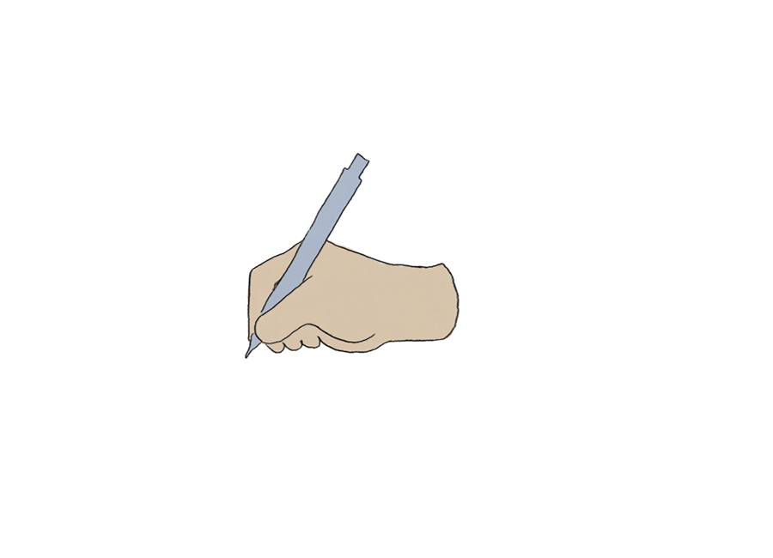
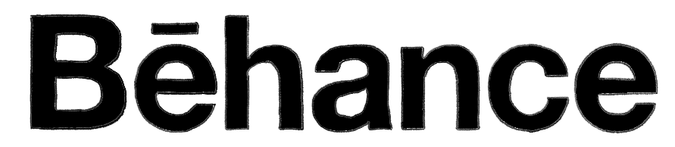
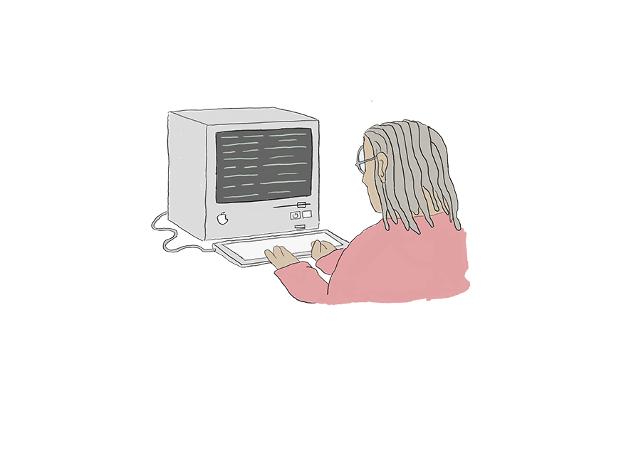
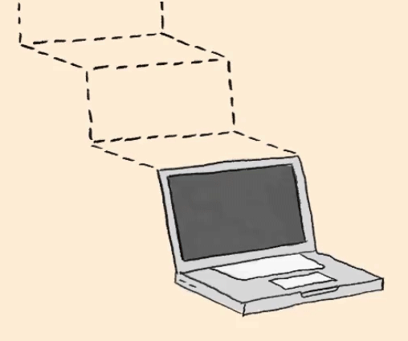
What are your deliverables?
I will create comic strips about the world. Most will be animated gifsl shared on both my Instagram and Behance..
These will live on:
These comics will also live on my developed site:
Animated comics
sketch-notes.co
(live now)
Some topics are hard to cover fully in a comic strip. I will make longer issues that include more text and code.
Progress shots on Instagram:
These comics will also live on my developed site:
Interactive comics
Shots posted on codepen
sketch-notes.co
(live now)
I will create a website that will host all the gifs and essays I create, as well as be a central entry into my brand.
These comics will also live on my developed site:
Website
sketch-notes.co
(live now)

Slide 16
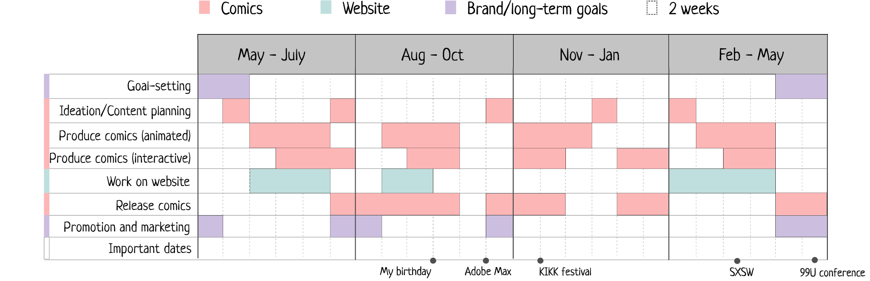
The Timeline (deliverable)
My yearly schedule will be alternating between working on my animated and interactive comics, and then preparing for various talks and conferences

Slide 17
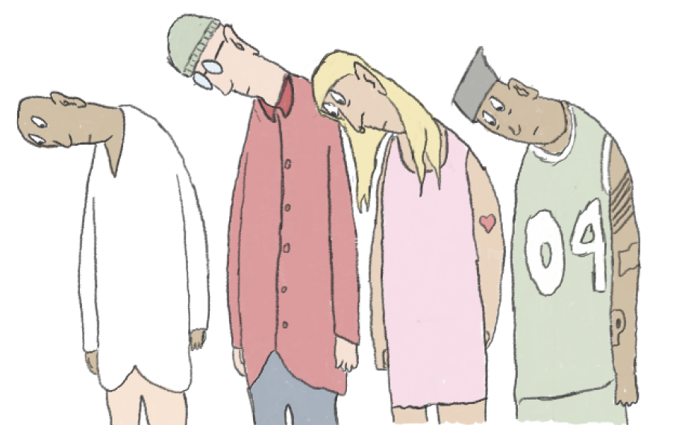
Sharing with the community
Throughout the residency,, my goal will be to connect with the hybrid creators. This includes the coder looking to experiment with Photoshop just as much as it does the photographer looking to incorporate illustration in their work.
I want to encourage creatives to step outside their comfort zones. Because of this, I will focus on a ‘Blank for Blank’ series, where I’ll choose a different Adobe tool and simply explore. The goal will be to shine light on how every product can be used by more than one type of creative
I want the Residency to be the start of my own community, so I will release a newsletter bi-monthly that will update my fellow creatives on what I’ve been working on, tips and tricks I’ve discovered, and upcoming workshops/livestreams/etc,

Slide 18
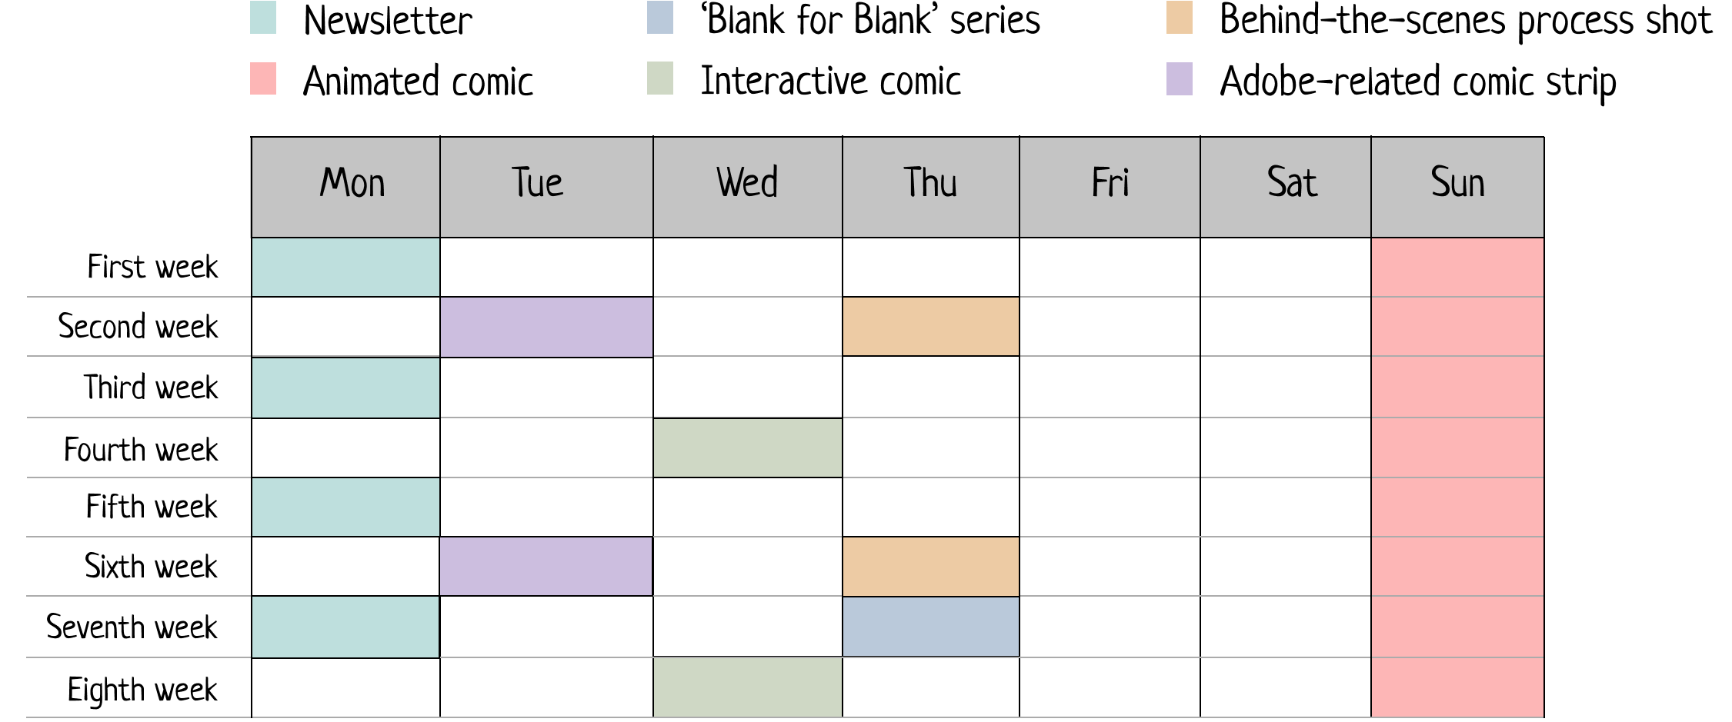
The Timeline (social)
I’ll be offering numerous peeks into my process, including newsletters, video loops of my process, and even a smaller sub-series focused on the Adobe products I use everyday

Slide 19
Project concept
Interactive comic strip costs
Hosting fees | $ 15 a month
Domain name and privacy | $ 25 a month
Email platform | $ 30 a month
Exceeded website traffic costs | $ 40 a month
Social media scheduling tool | $ 10 a month
Products/Services platforms (for selling ebooks, selling courses, etc) | $ 10 a month
Total | $ 130/mo | 1,560/yr
How?
The fees for this project will pertain mainly to the website. This includes hosting fees, domain privacy, and cushioned funds to account for any traffic that exceeds expectations

Slide 20
Project concept
Creator: Juweek Adolphe
Collaborators: Adobe
Audience: Technologists, educators, multidisciplinary creatives
Mentor: My ideal mentor would be someone who has created a webcomic of their own. A key part in the success of The Computers will be the quality of the stories it tells, so I want to look for mentors who have experience telling stories.
Animation is still a new skill for me, so technically I’d love to have mentors who can teach me tricks that’d raise the quality of my animations.
Finally, I want a mentor who also stays interdisciplinary in their subject matter. A big way for me to learn is by discussion, and bouncing off ideas. Having a routine discussion on nothing but art and the process will actually unlock quite a lot of creativity from me. Swoozie?

Slide 21
Project summary
Who - Juweek Adolphe (me) - An audience of: - technologists who are into art - artists who are into technology - creatives who work in multiple disciplines
What - A comic strip that plays with its medium. Sometimes it will be animated, sometimes it will be made interactive with code.
How - Adobe Photoshop, Fresco, After Effects - Estimated $1,000 for project hosting fees and marketing
When (on the months I release them) - about (4) animated comics a month - about (1) interactive comic a month - about (2) newsletters a month
Where - Brooklyn, NY | Instagram | Codepen | Behance
Why / impact - I want to help build up the multidisciplinary creative community - I want to push the definitions of illustration and code - I want to help demystify some topics by offering an accessible entry point into learning about them

